Slide 1
SQL
Basics

Slide 2

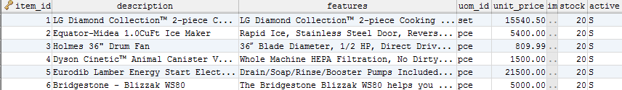
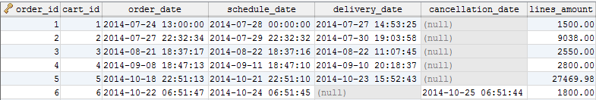
How applications store data?
columns
TABLE: Users
D a t a B a s e
rows
data
TABLE: Items
TABLE: Orders

Slide 3
Entity Relationship DB Model

Slide 4
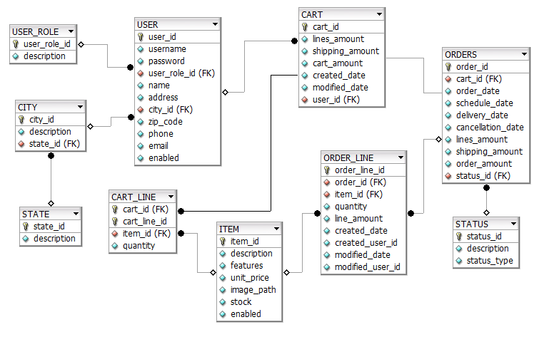
Table, Column, Key and Foreign Key

Slide 5
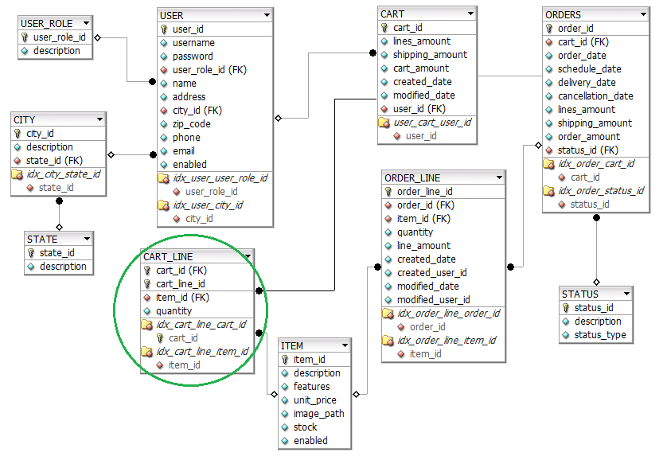
Indexes and Composite Key

Slide 6
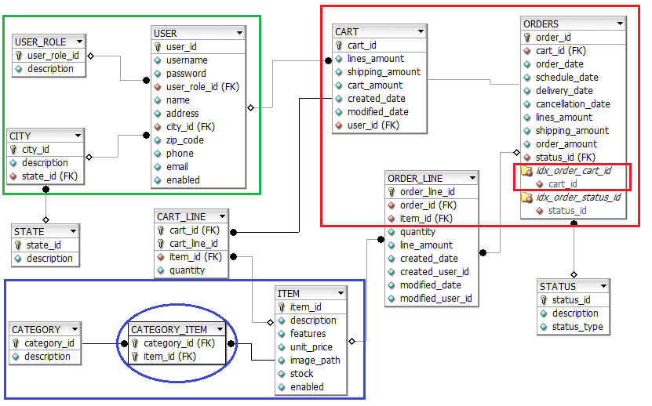
Relationships
One to Many, One to One (Unique Index) and Many to Many

Slide 7
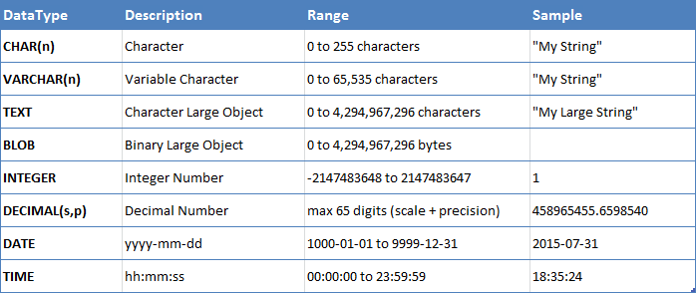
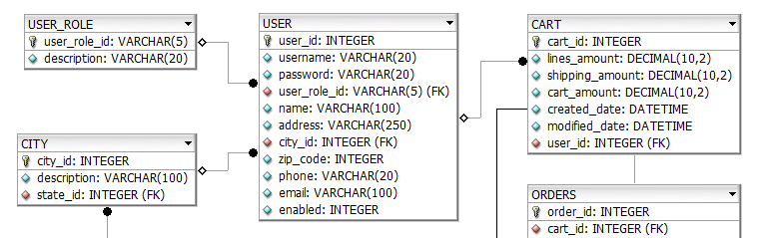
Physical Schema
MySQL DataTypes

Slide 8
Data Definition Language (DDL)

Slide 9
Create Table
CREATE TABLE TableName ( column_name1 data_type(size), column_name2 data_type(size), ...
PRIMARY KEY (colum_name) ON UPDATE RESTRICTION
);
CREATE TABLE USER_ROLE ( user_role_id VARCHAR(5) NOT NULL, description VARCHAR(20),
PRIMARY KEY (user_role_id)
);
CREATE TABLE CITY ( city_id INTEGER NOT NULL AUTO_INCREMENT, description VARCHAR(60),
state_id INTEGER NOT NULL,
PRIMARY KEY (city_id)
);

Slide 10
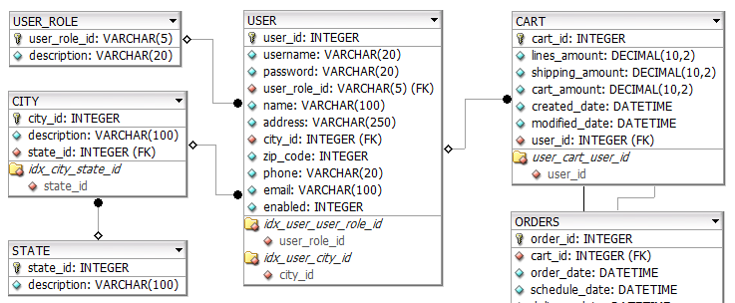
Crate Table and Drop Table
CREATE TABLE TableName ( column_name1 data_type(size), column_name2 data_type(size), ...
PRIMARY KEY (colum_name),
INDEX index_name (colum_name),
[CONSTRAINT constraint_name]
FOREIGN KEY(colum_name)
REFERENCES TABLE_NAME(colum_name)
ON DELETE RESTRICTION
ON UPDATE RESTRICTION
);
DROP TABLE TableName ;
CREATE TABLE USER( user_id INTEGER NOT NULL AUTO_INCREMENT, user_name VARCHAR(20),
user_role_id INTEGER NOT NULL,
name VARCHAR 100),
city_id INTEGER NOT NULL,
...
PRIMARY KEY (user_id)
INDEX idx_user_user_role_id (user_role_id),
CONSTRAINT fk_user_user_role
FOREIGN KEY(user_role_id)
REFERENCES USER_ROLE(user_role_id)
ON DELETE RESTRICT
ON UPDATE CASCADE,
CONSTRAINT fk_user_city
...
);

Slide 11
Data Modification Language (DML)

Slide 12
INSERT
INSERT INTO USER_ROLE(user_role_id, description) VALUES('USR','Registered');
INSERT INTO CITY(city_id, description, state_id) VALUES (12,'Ensenada',2);
INSERT INTO USER (username, password, user_role_id, name, address, city_id, zip_code, phone, email, enabled) VALUES ('admin','admin',‘USR','Adminstrator','Ensenada',12,22500,'6461510000','adming@softtek.com',1);
INSERT INTO CART (lines_amount, shipping_amount, cart_amount, created_date, modified_date, user_id) VALUES (2309.99, 60, 2369.99, '2014-07-24 13:00:00', SYSDATE(), 1);
INSERT INTO TableName ( column_name1,column_name2, ...)
VALUES (value1, value2, ...);

Slide 13
UPDATE and DELETE
UPDATE TableName
SET column_name1 = value1,
column_name2 = value2, ...
WHERE column_nameN = valueN;
UPDATE USER_ROLE
SET description = 'Registered User'
WHERE user_role_id = 1;
UPDATE USER
SET address = 'Registered User',
zip_code = 22800
WHERE user_id = 1
OR username = 'admin'
AND enabled = 1;
DELETE FROM USER_ROLE
WHERE user_role_id = ‘USR';
DELETE FROM TableName
WHERE column_nameN = valueN;
Make sure not to forget the WHERE clause.

Slide 15
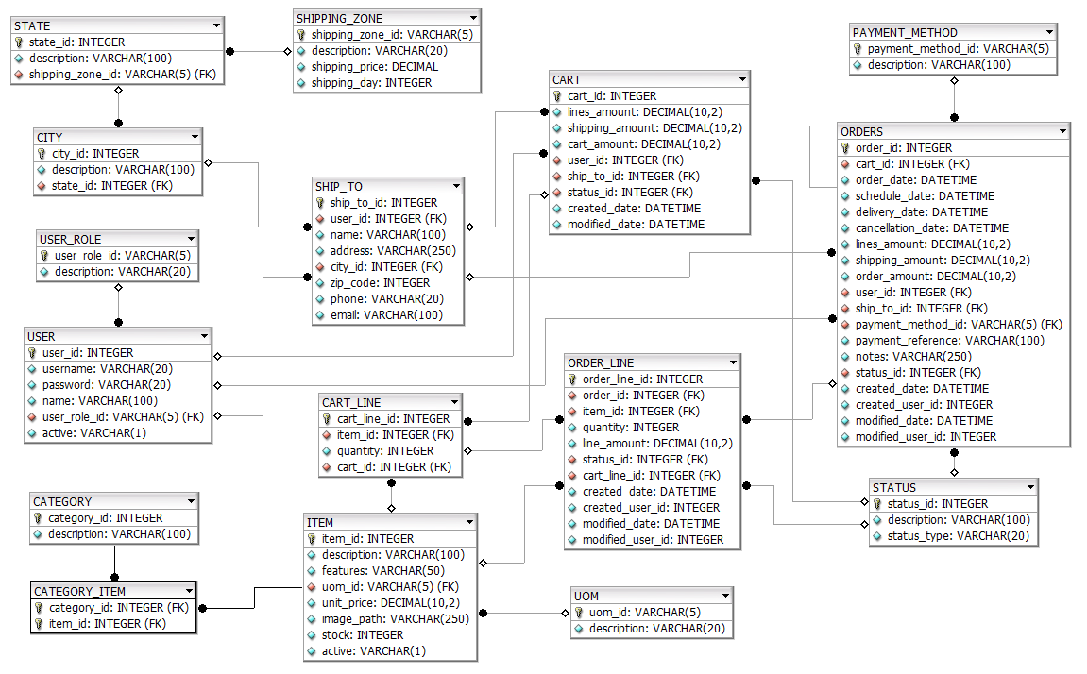
Exercise 1:
Create and populate the following MySQL Physical Data Model. Auxiliary repository files:
JavaAcademy/SQL/Execises/SQL [1] Exercise - ecomDB schema.sql
JavaAcademy/SQL/Execises/SQL [1] Exercise - ecomDB data.sql

Slide 16
Jorge Luis Gonzalez
jorge.gonzalezm@softtek.com
Instructor

